Slide 1

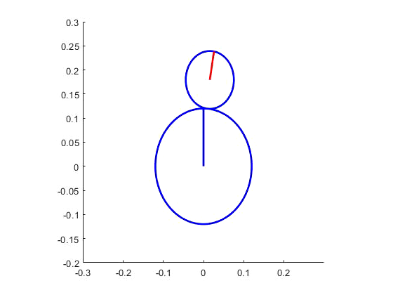
Control of a Rolling Balancing System
Timothy Dunn

Slide 2
What’s In Store
Project summary and update
Progress video questions
Open questions

Slide 3
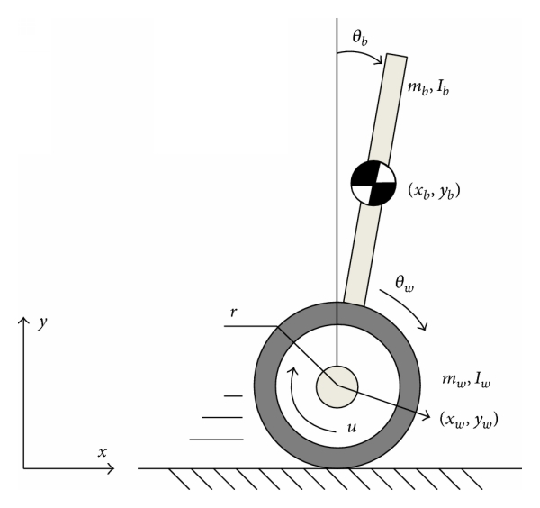
Under-Actuated Systems
https://www.hindawi.com/journals/mpe/2014/284216/fig1/

Slide 4
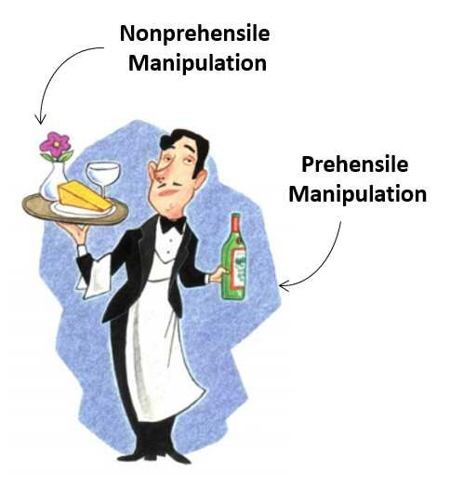
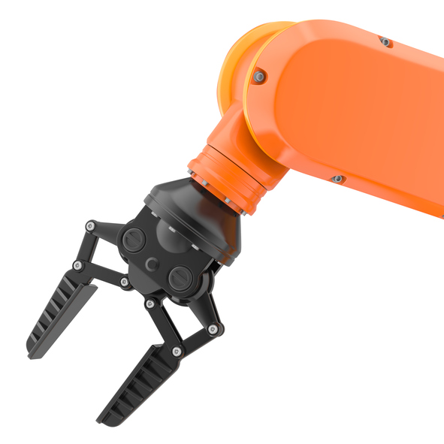
Prehensile Manipulation
https://www.researchgate.net/publication/310751102_Robot_Control_for_Nonprehensile_Dynamic_Manipulation_Tasks
https://www.robotics.org/blog-article.cfm/The-Emergence-of-Smart-Collaborative-Robot-Grippers/107

Slide 5
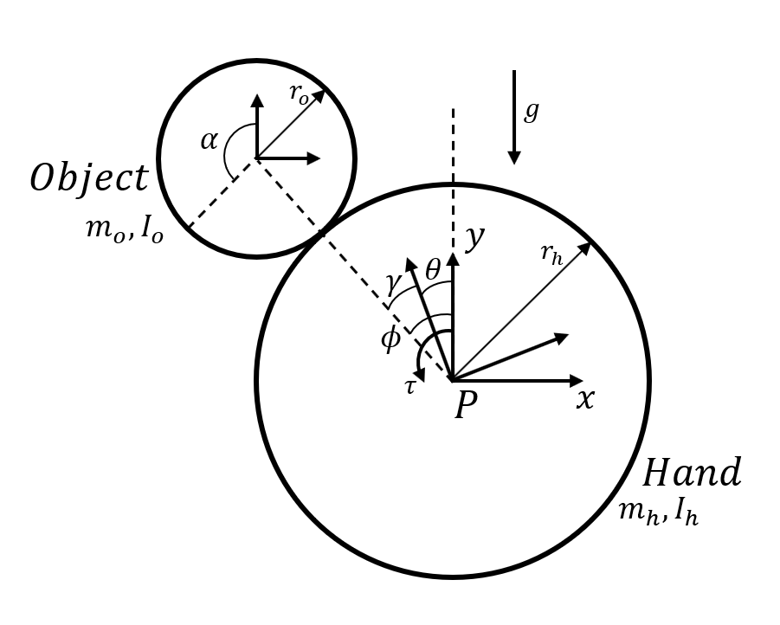

Modelling
$$\left[\begin{matrix}J_{h}+J_{o}\frac{r_{h}^{2}}{r_{o}^{2}} & {−J}_{o}\frac{r_{h}^{2}}{r_{o}^{2}} \\ {−J}_{o}\frac{r_{h}^{2}}{r_{o}^{2}} & m_{o}{\left(r_{h}+r_{o}\right)}^{2}+J_{o}\frac{r_{h}^{2}}{r_{o}^{2}}\end{matrix}\right]\left[\begin{matrix}\ddot{θ} \\ \ddot{ϕ}\end{matrix}\right]+\left[\begin{matrix}0 \\ −m_{o}g\left(r_{h}+r_{o}\right)sin⁡(ϕ)\end{matrix}\right]=\left[\begin{matrix}τ \\ 0\end{matrix}\right]$$

Slide 6
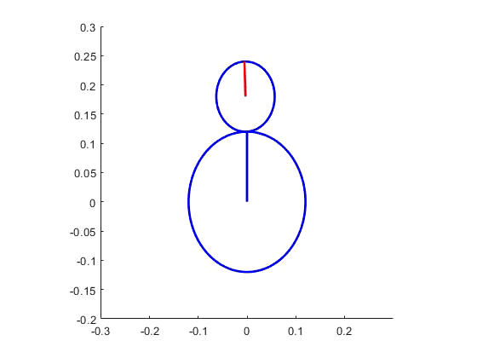
Control

Slide 7
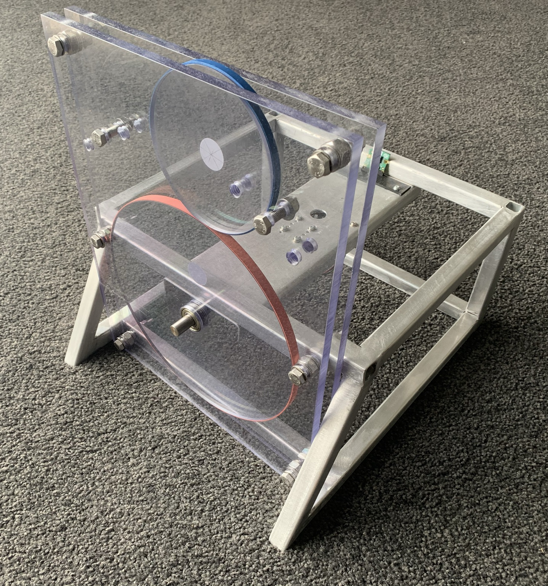
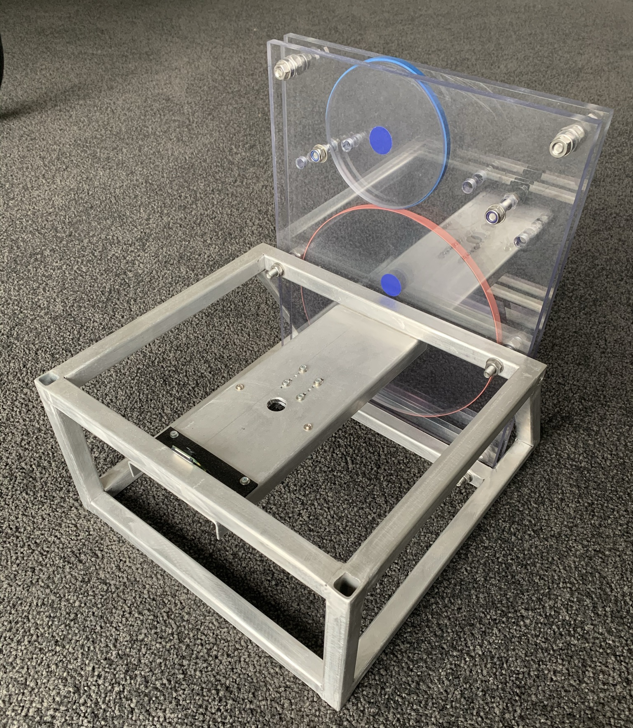
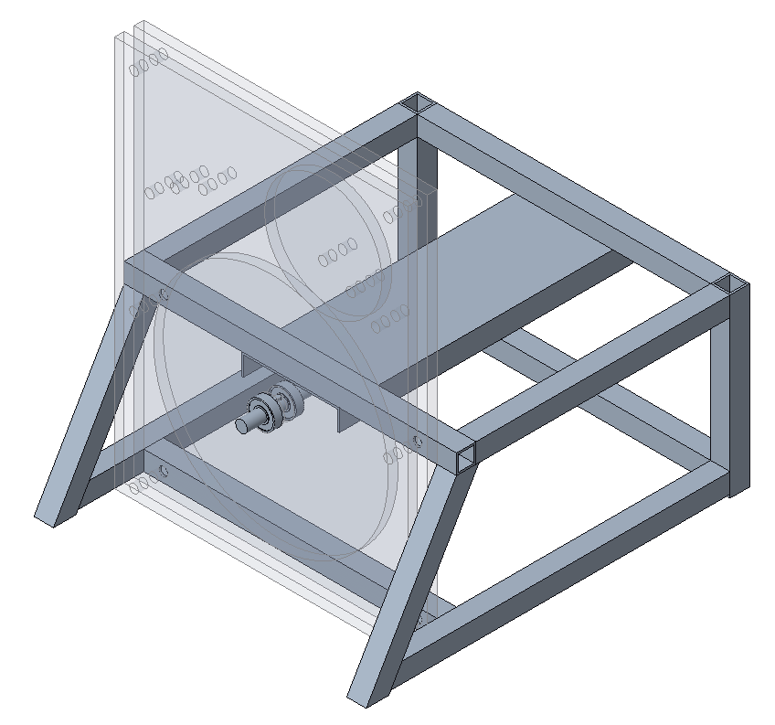
Experiment Apparatus Design
7

Slide 8
State Estimation
Bottom disk: rotary encoder on motor shaft
Top disk: computer vision process

Slide 9
Saturation Thresholding
Hue, Saturation and Value (HSV) Representation
Binary Representation
9

Slide 10
Blob Detection

Slide 11
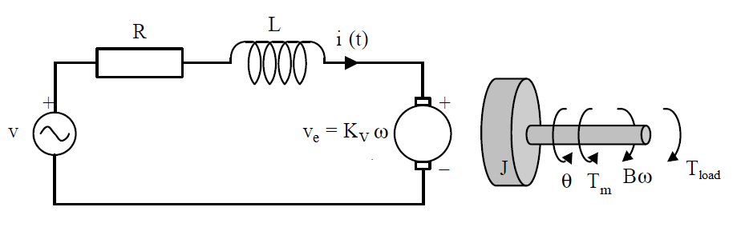
DC Motor System Identification
DC Motor Model

Slide 12
Friction Model

Slide 13
Final Motor Model

Slide 14
Torque and Velocity Control
Torque Control
Velocity Control
14

Slide 15

Results
Implementation complete, stability not achieved

Slide 16
YouTube Questions
“Were there problems arising from the image acquisition delay?”

Slide 17
Control Frequency Limit
10Hz Control Frequency
9Hz Control Frequency
17

Slide 18
YouTube Questions
“What do you think is the cause of the delay between events occurring and frames capturing that event?”

Slide 19
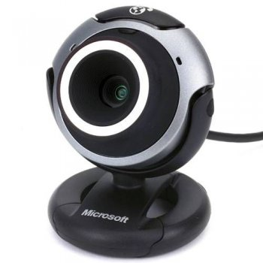
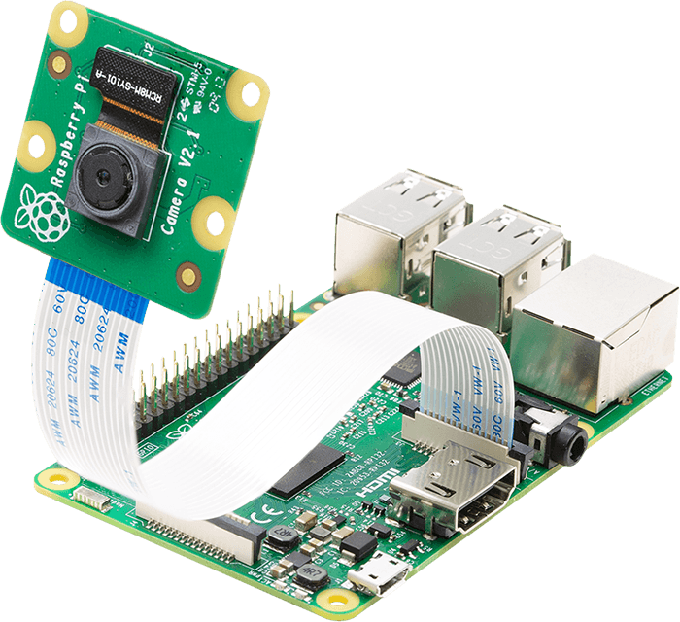
The Cameras
Microsoft
VX3000 Webcam
Raspberry Pi
Camera
https://www.arducam.com/wp-content/uploads/2020/02/raspberry-pi-camera-pinout-camera-2.png

Slide 20
Image Stream Process
Event
occurs
Exposure time
Post- processing
???
Frame
available
Transmit
~100us
<33ms
<5ms
Time
20

Slide 21
YouTube Questions
“What made you choose LQR over MPC?”

Slide 22
Questions?

